Slide 2
Variations of engineering students’ attitude towards mathematics across gender and age: A MIMIC model approach
Yusuf F. Zakariya
Department of Mathematical Sciences, University of Agder,
Kristiansand, Norway.
A presentation at the 20th SEFI Special Interest Group in Mathematics Seminar on Mathematics in Engineering Education
17 - 18 June 2021 in Kristiansand, Norway.

Slide 3
Outline
Research Background
Conceptualisation of attitude towards mathematics
Importance of attitude towards mathematics
Statement of the problem/Purpose of the study
Research questions
Research Methods
Participants and measure
Data collection
Data analysis
Results and Discussion
Research question one
The research question two and three
Conclusion
References

Slide 4
Research Background

Slide 5
Conceptualisation of attitude towards mathematics
The conceptualisations of, and the theoretical foundations for constructs such as attitude, anxiety, beliefs, motivation, emotions, and values as they relate to mathematics learning have generated heated debates among researchers.
Students’ attitude towards mathematics, for instance, is conceptualised as “affective responses that involve positive or negative feelings of moderate intensity and reasonable stability’’ (McLeod, 1992, p. 581).
Other researchers (e.g., Di Martino and Zan, 2009, Yavuz Mumcu and Cansız Aktaş, 2020) have conceptualised students’ attitude towards mathematics to comprise cognitive (e.g., knowledge and beliefs), affective (liking-disliking emotions), and behavioural (e.g., tendency to approach or refrain from mathematics activities) components.
Tentatively, attitude towards mathematics may be defined in the present study as students’ like/dislike and perceived usefulness of mathematics.

Slide 6
Importance of attitude towards mathematics
Despite the lack of coherence in the theoretical foundations of the students’ attitude towards mathematics, there seems to be an accumulation of evidence that establishes a strong contribution of the construct to students’ learning outcomes in mathematics.
Attitude towards mathematics has non-trivial effects on students’ performance in mathematics.
Studies show that attitude towards mathematics predicts students’ performance in mathematics better than some cognitive and personality constructs e.g., reasoning ability, extraversion, and openness.
Some other researchers have investigated the reciprocal effects of attitude towards mathematics and students’ performance in mathematics and found that there is non-trivial reciprocal effects between the constructs.
That means, previous attitude towards mathematics affects subsequent performance while current performance affects subsequent attitude towards mathematics.

Slide 7
Statement of the problem/Purpose of the study
Considering the crucial role of students’ attitude towards mathematics on performance, one may be interested to carefully investigate the measurement of the construct.
Admittedly, there have been some previous studies with this intention. However, some of the studies are exploratory/confirmatory of factor structure of the instrument or estimation of factor scores (e.g., Ayob and Yassin, 2017).
Some other studies are based on developing a new instrument or preparing a short form of an existing one (Yavuz Mumcu and Cansız Aktaş, 2020, Primi et al., 2020).
Meanwhile, there is a scarcity of studies on how the construct varies across gender and age.
The present study is a follow-up research on the validity of an attitude towards mathematics questionnaire that is used every two years to measure Norwegian students’ attitude towards mathematics.
The purpose of the present study is twofold:
First, to confirm the factor structure of the questionnaire in an independent sample from the initial study.
Second, to investigate the variations of the questionnaire across gender and age of first-year engineering undergraduate students

Slide 8
Research questions
The following research questions are raised and addressed in the present study:
Do the five items of attitude towards mathematics questionnaire measure a single factor?
Does the attitude towards mathematics vary across students’ gender?
Does the attitude towards mathematics vary across students’ age?
The author believes that empirical evidence to support answers to these questions will inform decisions on the use of this questionnaire for subsequent gender and age comparisons across universities in Norway.

Slide 9
Research Methods

Slide 10
Participants and measure
Participants
The sample of the study comprised 238 (189 males) first-year engineering students enrolled in engineering programmes at a Norwegian university.
Their age is distributed into the following intervals: 17-20 years (109), 21-25 years (98), 26-35 years (27), and over 36 years (4).
Measure
The instrument used in the present study, attitude towards mathematics questionnaire (AtMQ), is part of a national mathematics test that is administered every two years to first-year degree-seeking students in Norway.
It is a five-item questionnaire that is designed to measure a single construct of students’ attitude towards mathematics on a four-point Likert scale format from strongly disagree to strongly agree.
The students are to rate their agreement to a sample-item statement like, I work with math because I like it, in a response to the leading question of what are your attitudes toward mathematics?
Previous validation research on AtMQ has reported a good discriminant validity, reliability (ordinal coefficient alpha of .78), and construct validity of the instrument (Zakariya et al., 2020).

Slide 11
Data collection
The data are generated using online version of AtMQ that was administered to first-year engineering students via a SurveyXact link.
The data on students’ gender are coded as 1 for males and 0 for females.
The data on age groups are collapsed such that students between 17-20 years have a coded of 1 and those above 20 years have a code of 2 to indicate young and old students, respectively. As such, there are 109 young students and 129 old students. The age-group recoding is necessary to facilitate the use of Multiple Indicators, Multiple Causes (MIMIC) modelling.
A preliminary analysis show that the data contain neither excess Kurtosis nor excess Skewness. However, the data are not normally distributed as revealed by the significant values of both Kolmogorov-Smirnov’s and Shapiro-Wilk’s tests for all items.

Slide 12
Data analysis
The data are analysed with some techniques of structural equation modelling.
The weighted least square mean and variance adjusted (WLSMV) estimator was used to cater for the lack of normal distribution of the data.
A one factor five-item measurement model of AtMQ was evaluated against the generated data.
The model global fit was assessed using a combination of criteria. A model exhibits an excellent global fit of the data if chi-square value is non-significant, values of comparative fit index (CFI) and Tucker-Lewis index (TLI) are greater than or equal to .95, root mean square error of approximation (RMSEA) value is less than or equal to .06, and standardized root mean square residual (SRMR) value is less than or equal to .08.
Figure 1: A one-factor AtMQ

Slide 13
Data analysis
The variations of attitude towards mathematics, at the construct level, across gender and age are investigated with the MIMIC modelling.
MIMIC modelling is a structural equation modelling technique that is suited for investigating factor invariance across group memberships (covariates) by regressing the latent factor onto the covariate.
The idea of the MIMIC modelling is similar to the mean comparison tests (t-test or analysis of variance) in classical test theory. However, mean comparisons in MIMIC modelling take place at latent construct level rather than in observed scores as it is usually the case in classical test theory.
The mechanism of MIMIC modelling involves an evaluation of measurement model using group membership as a covariate.
In the present study, both gender and age group of students are used as covariates to investigate their effect on the attitude towards mathematics.
A significant effect of each of these covariates will suggest that AtMQ does not measure attitude towards mathematics, in a similar proportion, across each of the students’ gender types (female and male) and the membership of the age groups (old or young).
In contrast, non-significate effects of the covariates will confirm the measurement invariance of AtMQ across the students’ gender types and age groups.

Slide 14
Results and Discussion

Slide 15
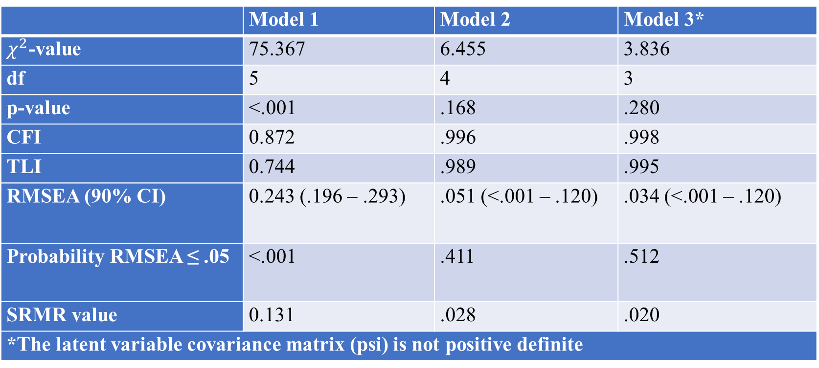
Research question one
Do the five items of attitude towards mathematics questionnaire measure a single factor?
Table 1. Goodness of fit statistics of three models of one-factor AtMQ
 | Model 1 | Model 2 | Model 3*
$χ^{2}$-value | 75.367 | 6.455 | 3.836
df | 5 | 4 | 3
p-value | <.001 | .168 | .280
CFI | 0.872 | .996 | .998
TLI | 0.744 | .989 | .995
RMSEA (90% CI) | 0.243 (.196 – .293) | .051 (<.001 – .120) | .034 (<.001 – .120)
Probability RMSEA ≤ .05 | <.001 | .411 | .512
SRMR value | 0.131 | .028 | .020
*The latent variable covariance matrix (psi) is not positive definite

Slide 16
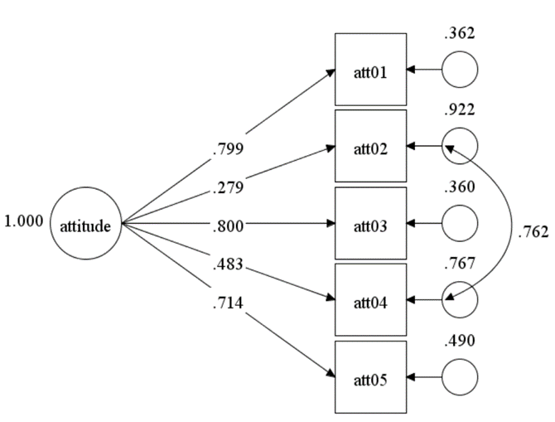
Research question one
Model 1
Model 2
Model 3

Slide 17
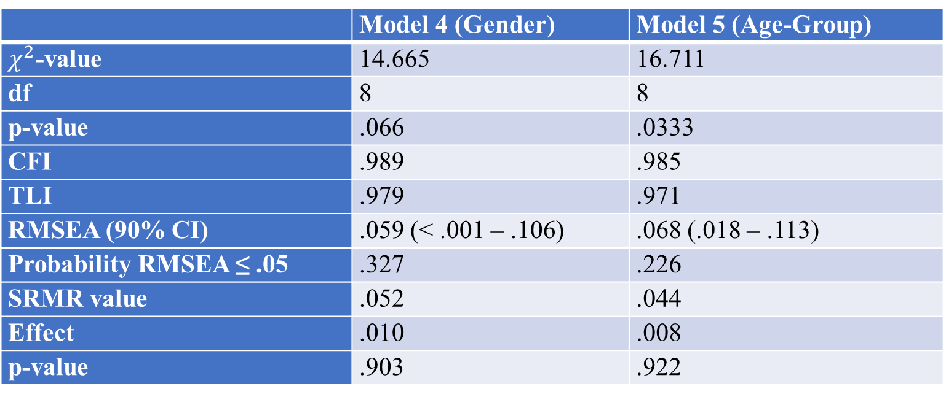
Research questions two and three
Does the attitude towards mathematics vary across students’ gender?
Does the attitude towards mathematics vary across students’ age?
Table 2. Goodness of fit statistics for measurement invariance of AtMQ across gender and age groups
 | Model 4 (Gender) | Model 5 (Age-Group)
$χ^{2}$-value | 14.665 | 16.711
df | 8 | 8
p-value | .066 | .0333
CFI | .989 | .985
TLI | .979 | .971
RMSEA (90% CI) | .059 (< .001 – .106) | .068 (.018 – .113)
Probability RMSEA ≤ .05 | .327 | .226
SRMR value | .052 | .044
Effect | .010 | .008
p-value | .903 | .922

Slide 18
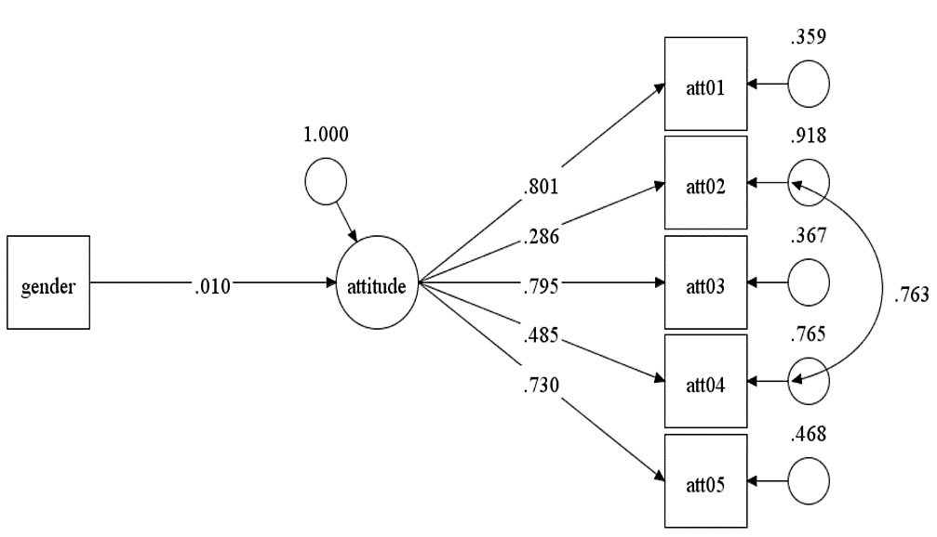
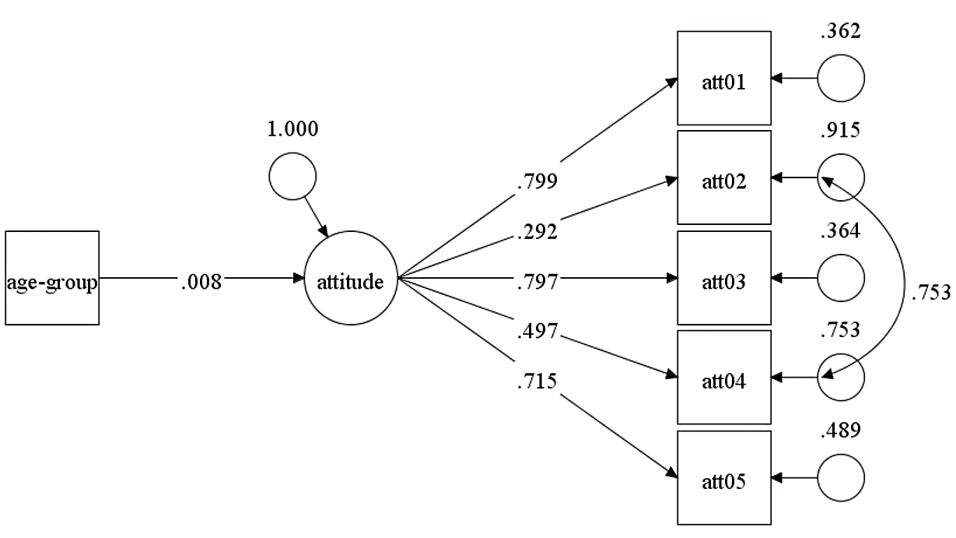
Research questions two and three
MIMIC model of attitude towards mathematics gender-invariance
MIMIC model of attitude towards mathematics age-group invariance

Slide 19
Conclusion

Slide 20
Concluding remarks
Students’ attitude towards mathematics is an important construct that influences students’ performance in mathematics even if there is no consensus among researchers on the conceptualisation of the construct.
On this premise, one may argue that a careful development and measurement of the attitude towards mathematics is non-negotiable. Thus, the present study was motivated with this intention.
As a follow-up study, the present study investigated the construct validity and gender/age invariance of an attitude towards mathematics questionnaire.
The most crucial finding of the present study is the invariance of attitude toward mathematics questionnaire across students’ gender and age groups.
The implication of this finding goes to researchers, in general, and the Norwegian National Mathematical Council to continue the use of AtMQ for measuring engineering students’ attitude towards mathematics regardless of gender and age of the students.

Slide 21
References
Ayob, A. & Yassin, R. M. 2017. A confirmatory factor analysis of the attitude towards mathematics scale using multiply imputed datasets. International Journal of Advanced and Applied Sciences, 4, 7-12.
Di Martino, P. & Zan, R. 2009. ‘Me and maths’: towards a definition of attitude grounded on students’ narratives. Journal of Mathematics Teacher Education, 13, 27-48.
Mcleod, D. B. 1992. "Research on affect in mathematics education: a reconceptualization". In: GROUWS, D. A. (ed.) Handbook of research on mathematics teaching and learning: a project of the National Council of Teachers of Mathematics. New York: MacMillan Publishing Co, Inc.
Primi, C., Bacherini, A., Beccari, C. & Donati, M. A. 2020. Assessing math attitude through the attitude toward mathematics inventory – Short form in introductory statistics course students. Studies in Educational Evaluation, 64.
Yavuz Mumcu, H. & Cansız Aktaş, M. 2020. Development of an attitude-towards-using-mathematics scale for high-school students and an analysis of student attitudes. International Journal of Mathematical Education in Science and Technology, 51, 3-25.
Zakariya, Y. F., Nilsen, H. K., Bjørkestøl, K. & Goodchild, S. 2020. "Impact of attitude on approaches to learning mathematics: a structural equation modelling approach". In: Hausberger, T., Bosch, M. & Chelloughi, F. (eds.) Third Conference of the International Network for Didactic Research in University Mathematics. Bizerte, Tunisia: University of Carthage and INDRUM.

