Slide 1






New Guidelines for the National Curriculum Regulations for Engineering Education in Norway
(with emphasis on Mathematics)
Anders Tranberg (University of Stavanger)
On behalf of
Mette Mo Jakobsen (Universities Norway/University of Agder)
Inger Johanne Lurås (University of South-Eastern Norway)
Arvid Siqveland (University of South-Eastern Norway)
Thomas Gjesteland (University of Agder)

Slide 2
Becoming an “Engineer” in Norway: Terminology and landscape
The title ”Ingeniør” is in Norway awarded to persons who complete a suitably accredited 3-year (180 ECTS) education. The National Curriculum Regulations for the Bachelor’s Degree in Engineering is intended to provide a National Standard for all Engineering degrees, which in turn is informed by international standards.
The Regulations in themselves are rather brief, but are supplemented by National Guidelines, fleshing out how the regulations should be(?) understood and implemented.
Engineers may proceed to a 2-year (120 ECTS) Master’s degree in technology, which is not regulated.
However: The title “Sivil-Ingeniør” is protected, and is awarded to persons who complete a Master’s degree in technology, on top of a 3-year Engineering Bachelor’s degree fulfilling additional requirements on Maths, Statistics, Physics, Chemistry and IT content. Being a “Sivil-Ingeniør” is popular and lucrative in the Norwegian job-market.
Regulations + Guidelines + Siv. Ing. = Norwegian framework for engineering education.
3-year Bachelor’s degree fullfilling Regulations
(detailed by Guidelines)
→ Engineer title
If bachelor’s degree boosted with extra Maths, Statistics, Physics, Chemistry and IT
2-year Master’s degree in Technology
Master in technology
Sivil-Ingeniør title

Slide 3


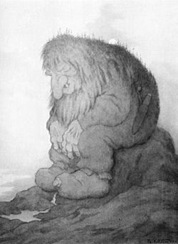
Engineering degrees in Norway are offered at 9 separate institutions.
Standardisation requires coordination. The government body Universities Norway (UHR) are tasked with this.
The Regulations were updated in 2018 (new law).
New updated Guidelines have been created through a comprehensive process involving representatives from Universities and Teaching Colleges.
Dedicated working groups on Maths and Statistics, Physics and Chemistry, IT.
The deciding body of the UHR is composed of senior management of the relevant institutions.
Final adoption, November 2020.

Slide 4

Regulations, Guidelines, and Interpretations
Recurring issues to consider:
What is the purpose of the Regulations?
Setting a national standard, calibrated to international standards(?)
What is the status of the Guidelines?
Mandatory minimal requirements, that all degree programmes must fulfill?
Recommendations and suggestions that institutions may choose to follow at their own discretion?
Both? (Is that possible?)
What is the role of Maths & Natural Sciences in engineering education:
Tools, only to be included and used to support later technical subjects?
Stand-alone learning goals, in themselves part of the education of an engineer.
Important “on-the-ground” when designing programs. Lack of clearly stated and consistent formal documents can lead to confusion and conflict.
What is an engineer?
What should an engineer be?
Is it well-defined?
Should it be well-defined?
Is it defined by the engineering tasks of today?
Should it be defined by engineering tasks of tomorrow?
Is it important?
Who is it important for?
And so on and so forth….

Slide 5
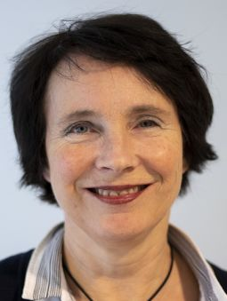




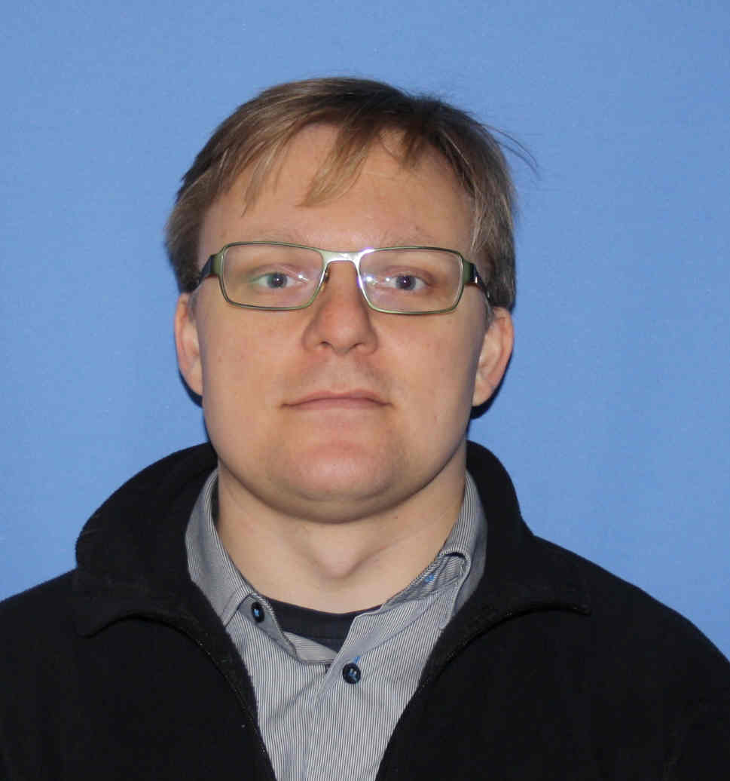
Focus on Mathematics
UHR initiated a working group on mathematics and statistics composed of representatives from all institutions offering engineering degrees.
Sub-group of 3 people to write concrete document.
Submitted to broader working group, updated with feedback.
Submitted to UHR, updated with feedback.
Outset:
Guidelines are mandatory.
Strategy:
  Survey current practice in sector in Norway.
  Survey international framework (SEFI).
  Define limited set of central Content to cover.
  Define minimal number of ECTS in maths and statistics (Volume).
  Define set of learning Goals (Knowledge, Skills, General Competence).
  Be concise. Use the word “must”.
  No further recommendations.

Slide 6
Mathematics Guidelines in Norwegian Engineering Education
(Abridged)
Minimum Volume of 20 ECTS of Mathematics (+ 5 in Statistics, separate learning goals and content)
For engineers, mathematics is a tool.
Numerical methods enter when analytic methods fail.
Formal proofs used when essential to the understanding of concepts and algorithms.
Does not have to be in the form of stand-alone maths courses.
Learning Goals:
K1: Maths as foundation for other subjects.
K2: Explain concepts and perform numerical and analytic calculations within chosen topics.
K3: Formulate mathematical models, within own field of study.
S1: Master relevant mathematical language.
S2: Mathematical reasoning.
S3: Formulate engineering problems in mathematical language.
S4: Gather, analyse and present numerical data.
S5: Validate choice of mathematical tools for given task.
S6: Programming for numerical problem solving.
S7: Assess output of calculations.
Content to be covered, mostly SEFI level 1:
Calculus, part 1: Functions, inverse functions, limits, continuity, derivation, integration, methods of integration, ODE’s and modelling.
Linear algebra: Matrices, determinants, systems of linear equations, eigenvalues and eigenvectors.
Calculus, part 2: Complex numbers, functions of multiple variables, partial derivative, Laplace transform, series, power series, Fourier series, finite difference equations.

Slide 7
Example Implementation: University of Stavanger
Semester 1
Mathematical Methods 1, 10 ECTS
(calculus, complex numbers, integration methods, ODE)
Mechanics*, 10 ECTS
(Newtonian mechanics, energy, momentum, forces, angular momentum, 3D dynamics)
Programming in Python, 10 ECTS
(Introductory programming)
Semester 2
Mathematical Methods 2, 10 ECTS
(linear algebra, Taylor, Fourier series, two-variable calculus, application of Python)
Probability and Statistics 1, 10 ECTS
(basic probability, distributions, basic statistics, parameter estimation, application of R)
Additional Natural Science courses included in some programmes:
Thermo-/Fluiddynamics (10 ECTS)
Vector analysis (10 ECTS)
Physics Lab (10 ECTS)
Discrete Mathematics (10 ECTS)
Prob. and Statistics 2 (10 ECTS)
Further chemistry for Chemistry .
Further programming for Data.
Electronics for Electrical.
Semester 3
Numerical mathematics, 5 ECTS
(Difference equations, matrix manipulations, Python-context)
Basic Chemistry, 5 ECTS
(Introductory organic, inorganic chemistry, lab)
* Data + Electrical have a different setup in physics.
The University of Stavanger made it a priority to qualify for Siv. Ing.. Boosted Bachelor’s degree!
> 25 ECTS Maths → 25 ECTS
> 5 ECTS Statistics → 10 ECTS
> 7.5 ECTS Physics → 10 ECTS
> 0 Chemistry → 5 ECTS
> 5 ECTS IT/programming → 10 ECTS

Slide 8

But there is a problem….
As the Guidelines were adopted by the UHR, their status became “Recommended practice”.
The main battleground is in Physics and Chemistry, rather than Maths and Statistics.
No requirements of Chemistry (Goals, Volume, Content).
No requirements on Physics Volume (7.5 ECTS for Siv. Ing.). Several comprehensive Learning Goals, but inconsistent with lack of Volume and Content requirements.
Difficult to identify and ensure a common standard. Inconsistent with Regulations?
TBC…
Some institutions now experience conflicts between:
Proponents of a mandatory standardized core of Goals, Volume, Content, defining “Engineer”, independent of specialisation.
Advocates of maximum freedom of each institution/department to design their own degree programmes, with maths tailored to each specialisation, in Goals, Volume and Content.
Both positions originate in wish to provide “best” possible engineering education, but disagreement as to what “best” is.
Both can now find support for their position in the Guidelines:
  ”Must” for stated Goals, Volume, Content.
  Overall status of document is “Recommendations”.

Slide 9
Thank you for your attention!

