Slide 1
New use of digital teaching tools to connect with students during Covid-19
Arnhild Lunde
Tonje Vedde Fiskerstrand
Department of ICT and Natural Sciences, NTNU
SEFI Special Interest Group in Mathematics Seminar 2021
Norwegian University of Science and Technology

Slide 2
Background
Started to use iPad with OneNote
New classrooms without blackboards
Started to use OneNote
Winter 2019/2020
March 2020:
Closed campus →
Streaming of the digital teaching
2020
2019

Slide 3
New challenge
Started to use iPad with OneNote
New classrooms without blackboards
Started to use OneNote
Winter 2019/2020
March 2020:
Need digital tools for teaching and supervising students →
Could OneNote solve this?
2020
2019

Slide 4
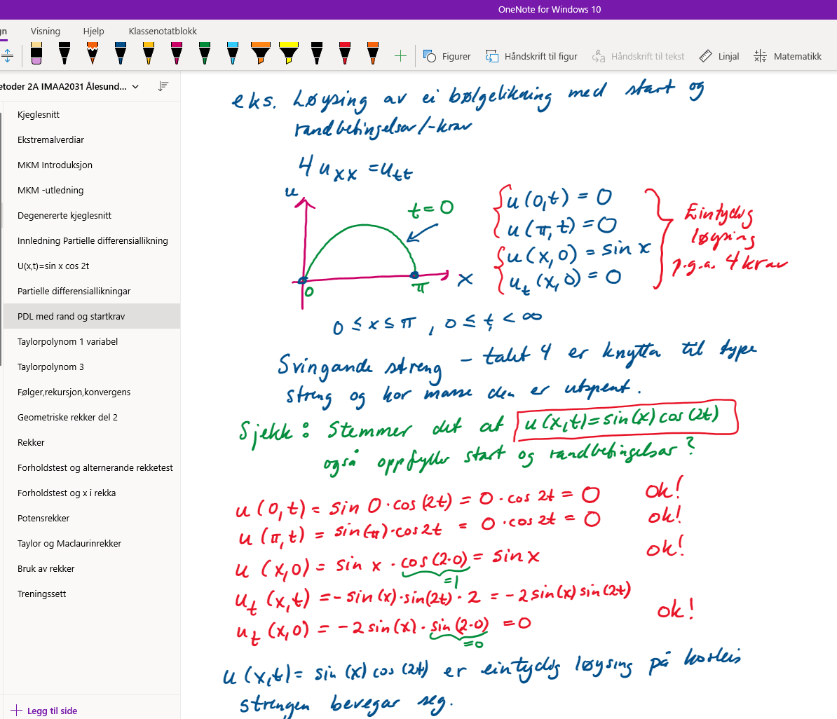
Method - Teaching
OneNote – live lecture notes
Immediately available
Always available
Easy to edit/improve
Automatic save
Chapter division
Challenges with syncing
Less visible screen
Unlimited space

Slide 5
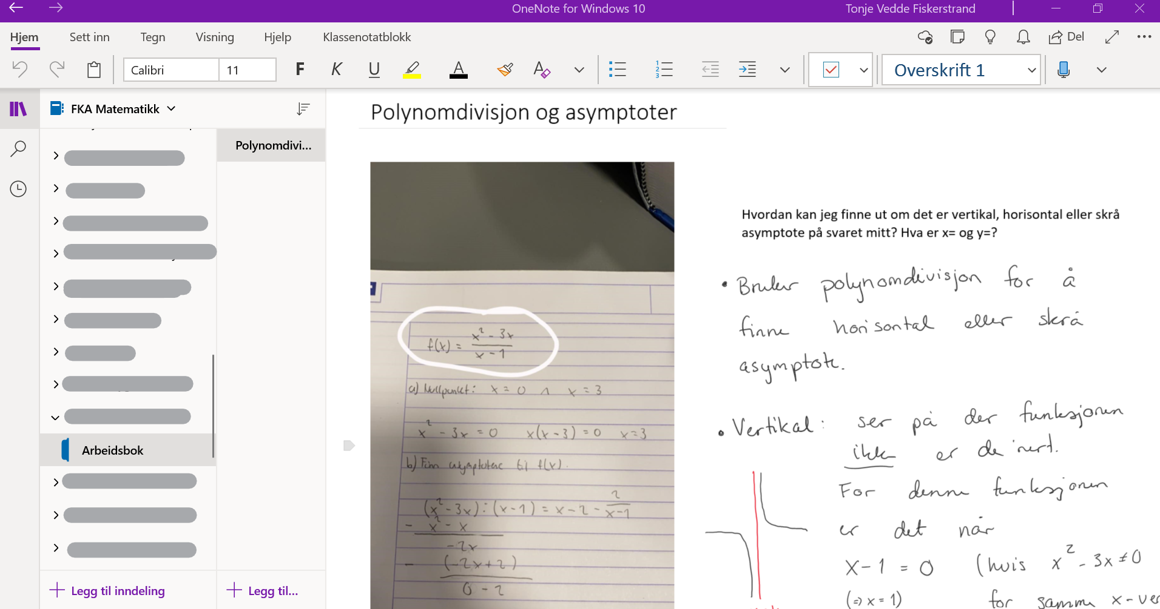
Method - Supervising
OneNote Class Notebook – shared notes
Kate Student

Slide 6
Results
Connection with students during lockdown
Active learning with feedback
Easier to change between in-site and streamed teaching
Digital notebook is now the new standard
Students prefer in-site teaching with digital notebook

Slide 7
Conclution
We did connect with students both during teaching and supervising with digital teaching tools
After Covid-19:
Prefer in-site teaching with use of digital teaching tools
How can we engage more students to use the Class Notebook?

