Slide 1


Slide 2
Transformed and Improved Learning Experiences of Mathematics in Engineering Programmes: Contributions from Mathematics Education Research
Simon Goodchild
Department of Mathematical Sciences, University of Agder

Slide 3

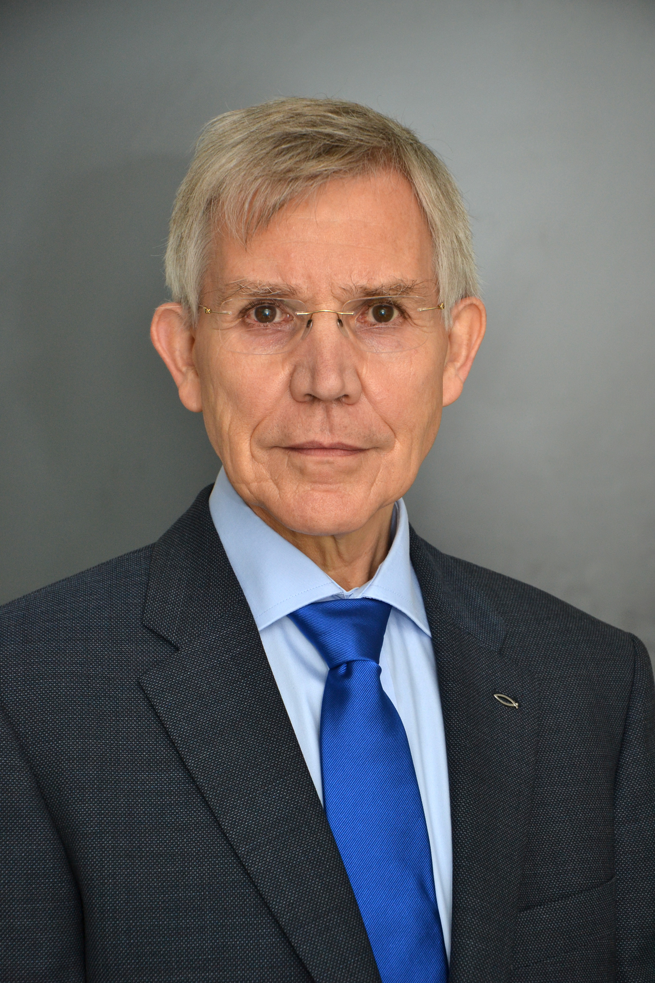
ME
MY IMAGINARY COMPANION

Slide 4
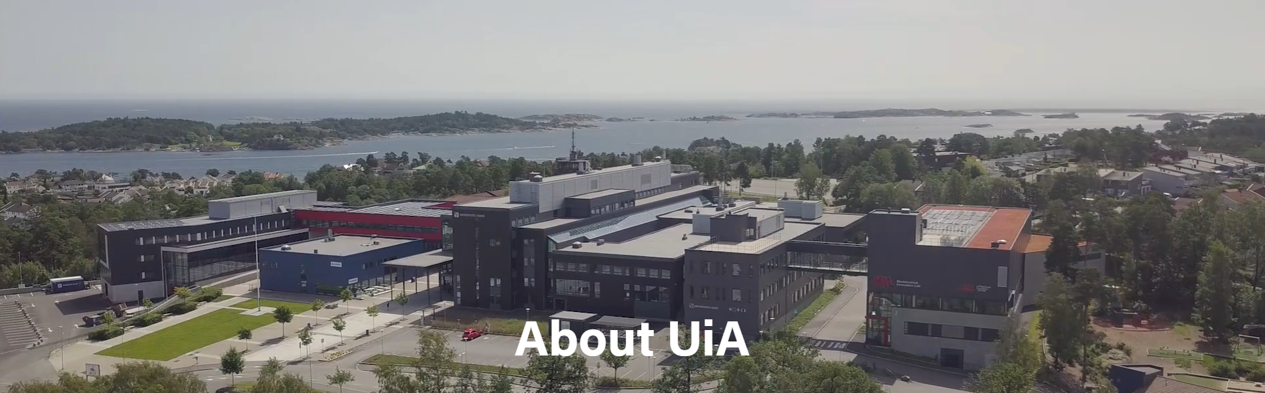
Grimstad Campus

Slide 5
Kristiansand Campus

Slide 6
MatRIC’s vision is of students enjoying transformed and improved learning experiences of mathematics in higher education.

Slide 7
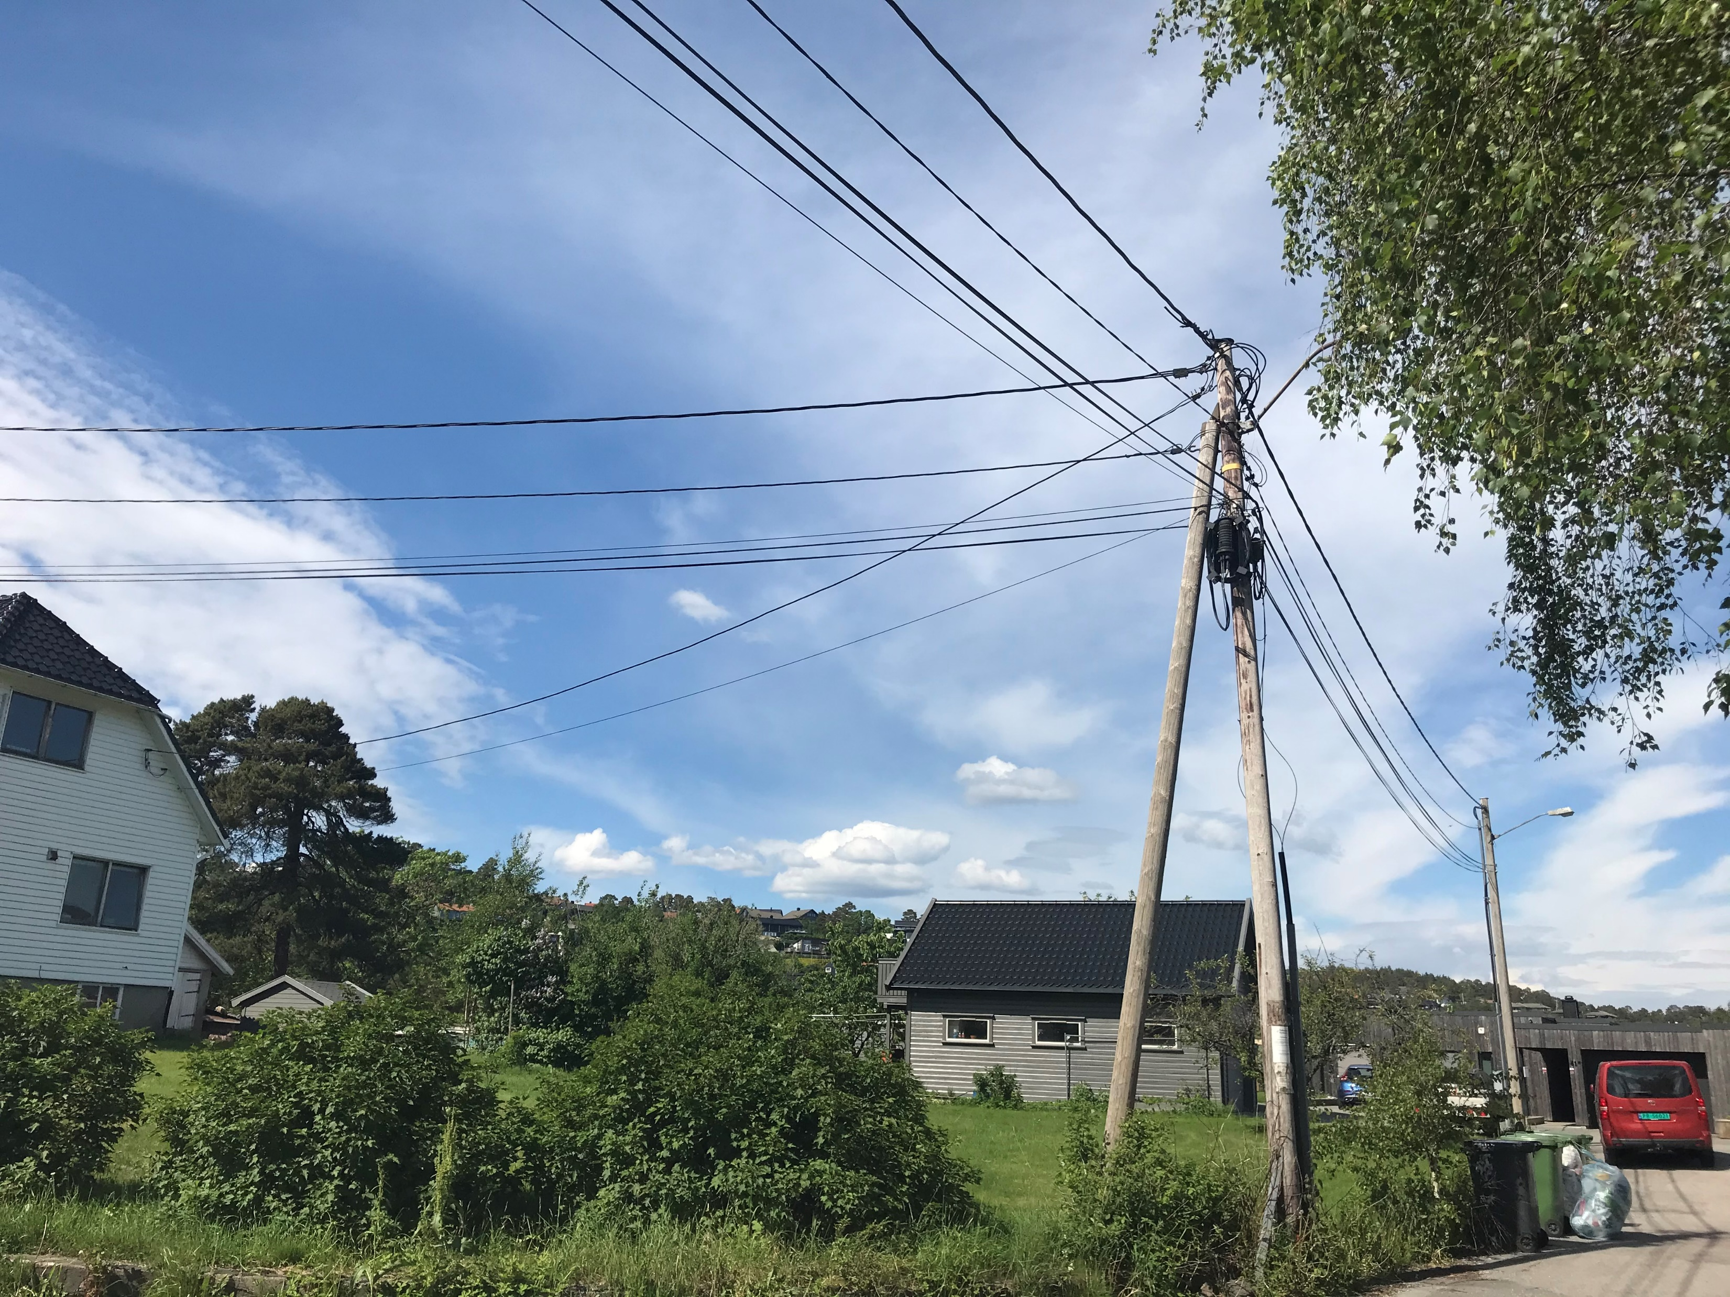
Making connections and networking

Slide 8
Networking
Mathematics learning support
Student engagement and participation
Mathematics teaching development

Slide 9
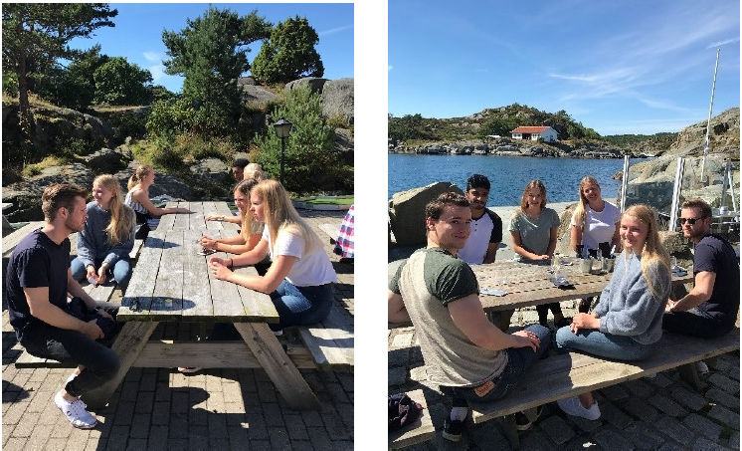
Student Learning Assistant Camp at Skottevik Holiday Centre

Slide 10
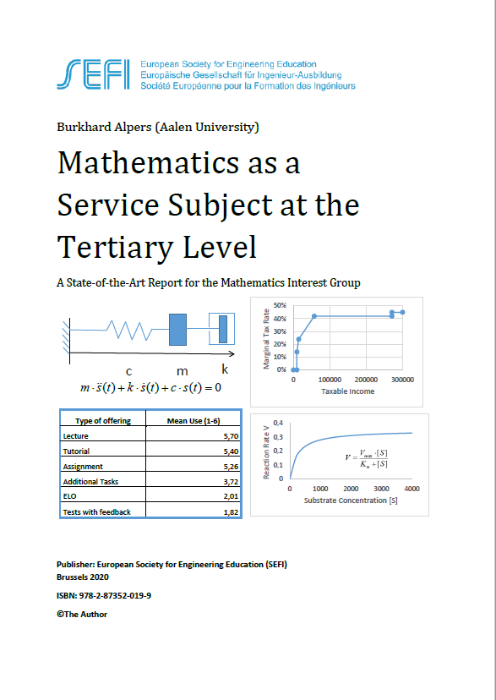
You can read more about MatRIC and other European centres working to improve mathematics education in engineering programmes in this report
Alpers, B. (2020). Mathematics as a service subject at the tertiary level: A State-of-the-Art Report for the Mathematics Interest Group. European Society for Engineering Education

Slide 11
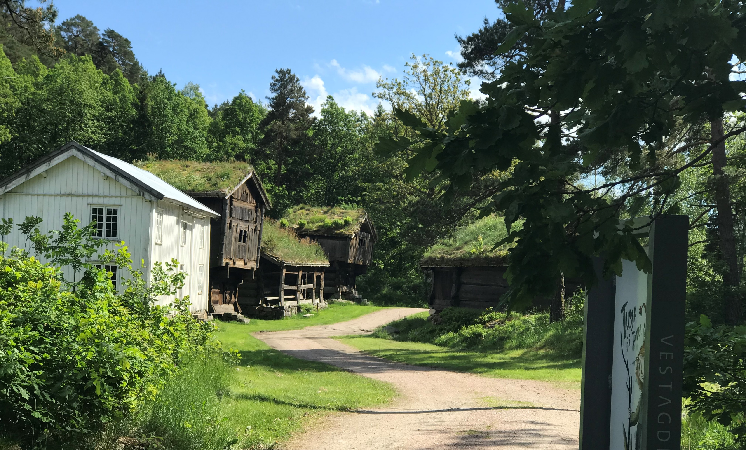
You are a mathematics education specialist, so you can help me. My masters level students perform very poorly at the mathematics that I teach them. Tell me, what should I do to improve their performance!
Agder County Open Air Museum
Kristiansand

Slide 12
Multi-national
Multi-lingual (English was language of instruction, that is L2+ for all
Followed previously distributed lecture notes
Transmission approach (“Chalk-talk”)

Slide 13
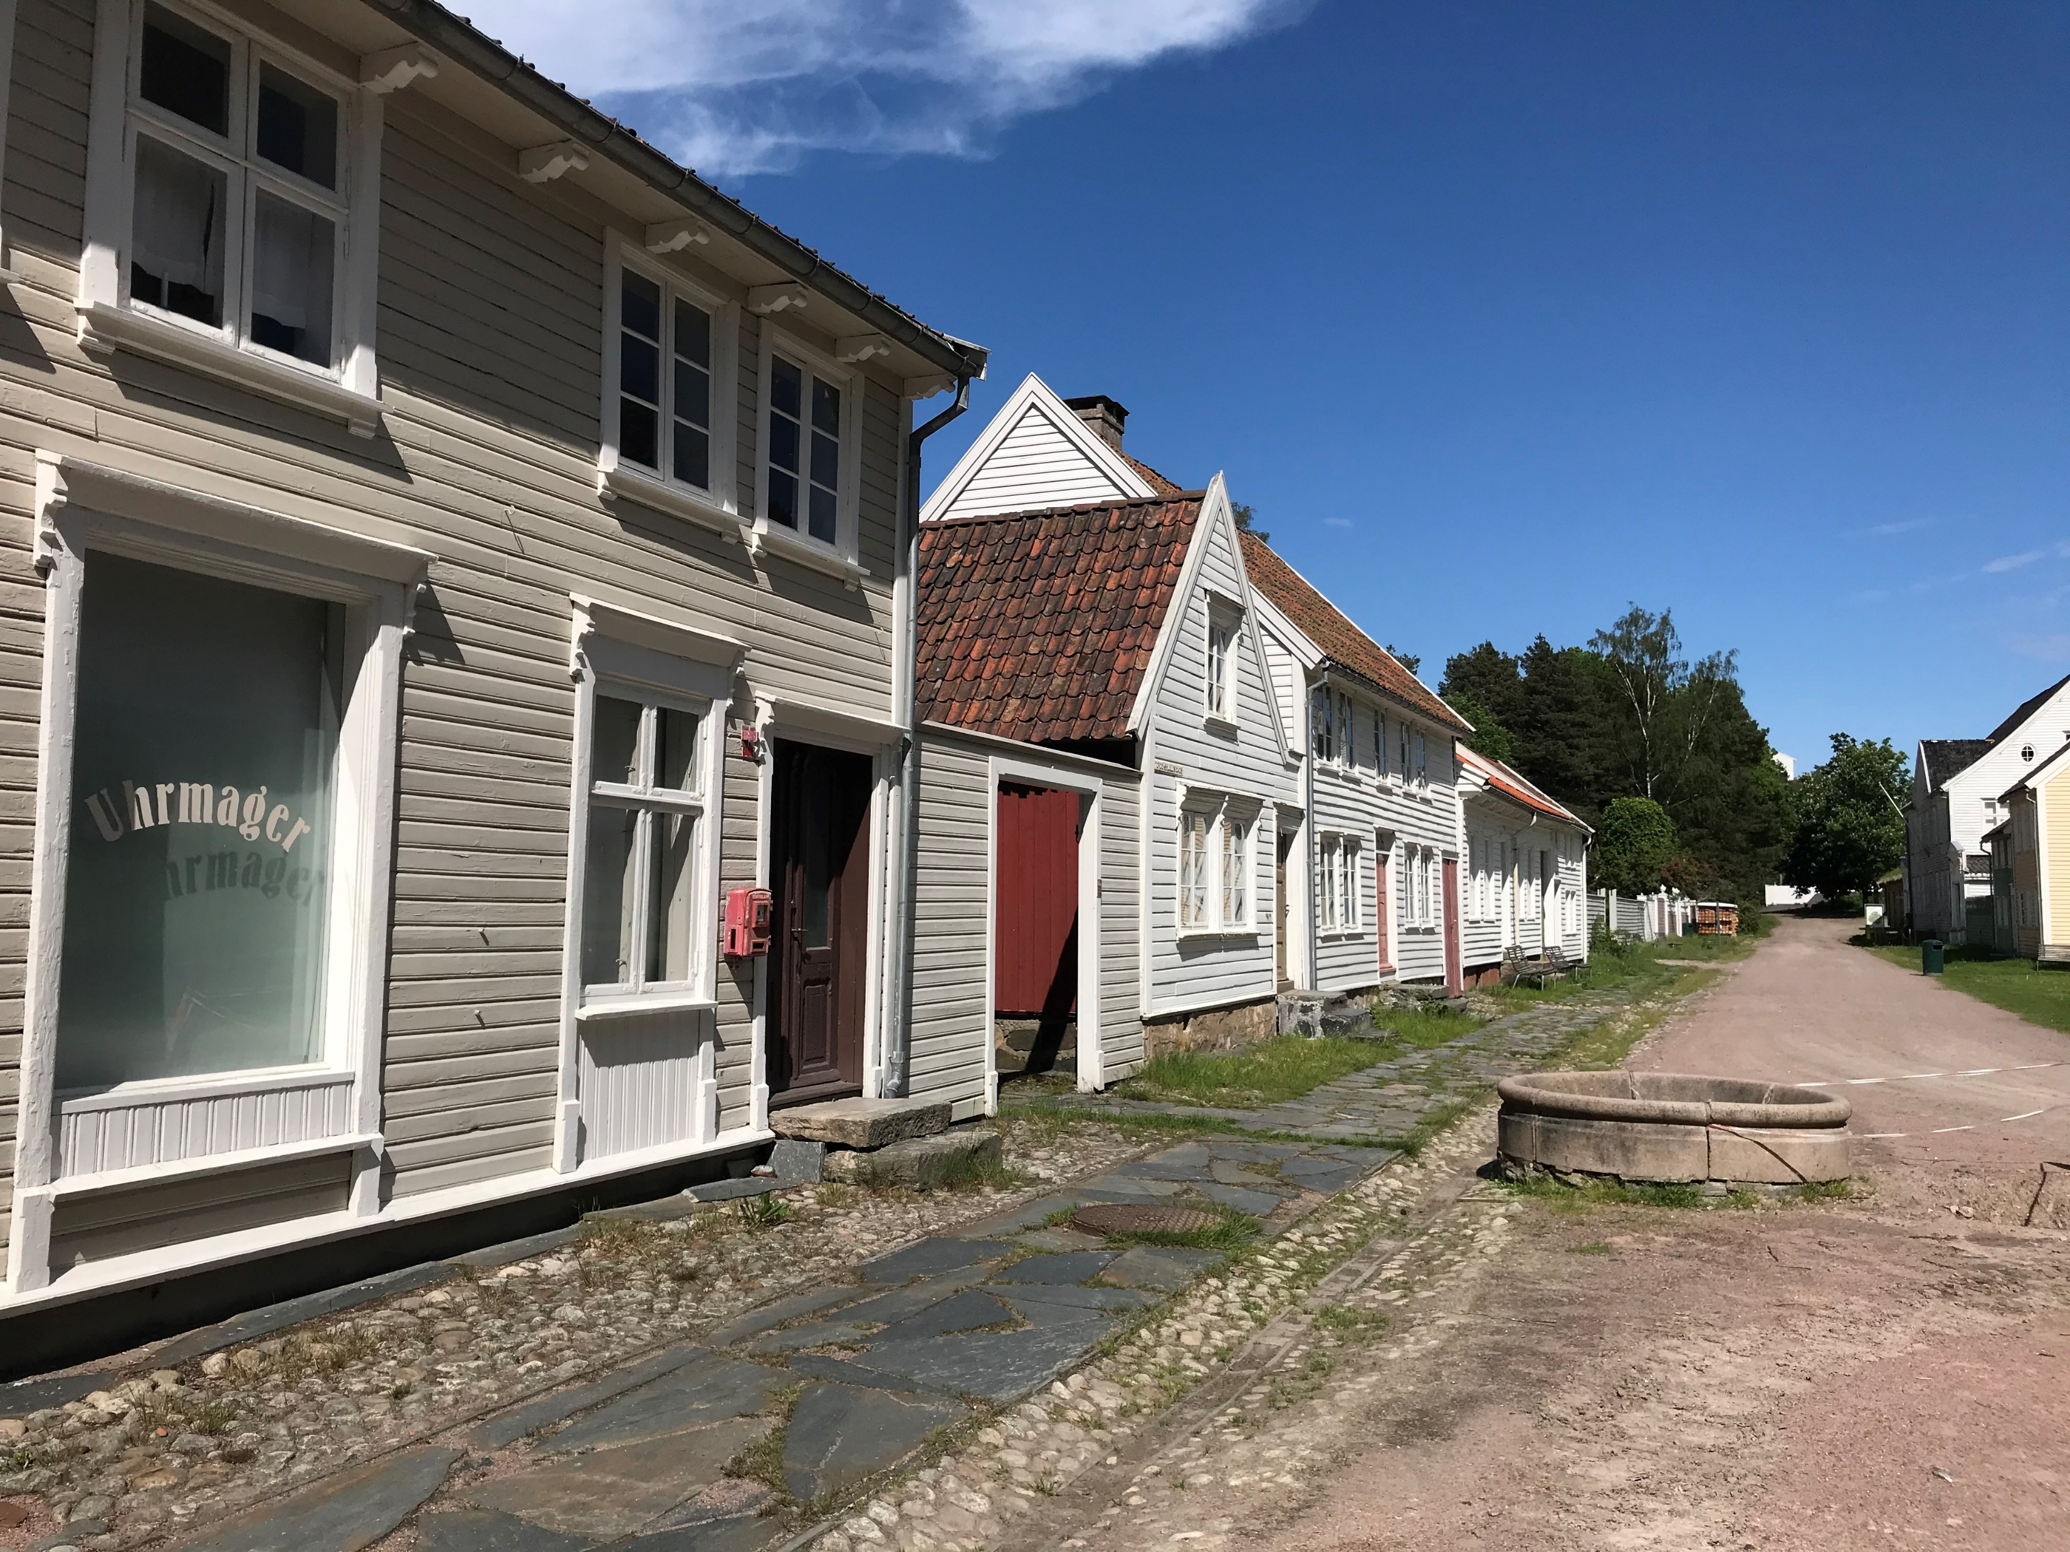
So what happened?

Slide 14
Procedure and meaning
Technique and rationale
Does that mean you think I should just ask my students to do the teaching?
Reference:
Hiebert, J., & Lefevre, P. (1986). Conceptual and procedural knowledge in mathematics: An introductory analysis.

Slide 15
Students not actively engaged
Students not active partners
OK, so what were the circumstances and what was there to understand in the situation you described?

Slide 16
What is so special about students learning actively?
References:
Bonwell, C. C., & Eison, J. A. (1991). Active Learning: Creating excitement in the classroom.
Freeman, S. et al. (2014). Active learning increases student performance in science, engineering, and mathematics.
Theobald, E. J., et al. (2020). Active learning narrows achievement gaps for underrepresented students in undergraduate science, technology, engineering, and math.

Slide 17

Julian Williams
Transmaths Project (University of Manchester)
Transmissionist teaching
Connectivist teaching
connectivist teaching results in better student attitudes towards their learning and progress in learning.

Slide 18
But you have said that it is important to understand, and I still do not see why active learning, or connectivist teaching is important.
Surely students can be active in lectures,
I expect my students to be actively thinking as I am presenting the mathematics.

Slide 19
Deep and surface approaches to learning
A student that takes a deep approach - seeks meaning and understanding.
A deep approach entails more effort.
Increased interest, better understanding and more resilient learning outweigh the cost of the additional effort involved.
Reference:
Marton, F. & Säljö, R. (1976).
On qualitative differences in learning
I - Outome and process;
II - Outcome as a function of the learner’s conception of the task.

Slide 20
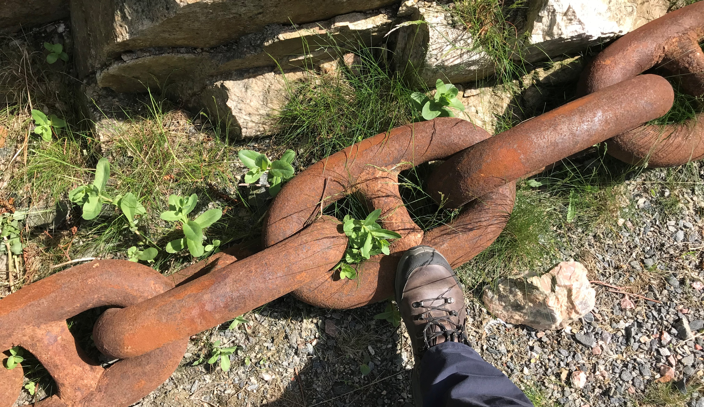
A chain reaction: active learning, - to engaged students, - to deep learning, - to meaningful learning, - to interest and motivation and, - to the development of conceptual, versatile and resilient knowledge.

Slide 21
I do not think it is reasonable to expect the students to do all the teaching! What else can I do to promote deep learning?

Slide 22
Create opportunities to learn
I do not think it is reasonable to expect the students to do all the teaching! What else can I do to promote deep learning?

Slide 23
Create opportunities to learn
Promote effective learning strategies
I do not think it is reasonable to expect the students to do all the teaching! What else can I do to promote deep learning?

Slide 24
Create opportunities to learn
Promote effective learning strategies
Develop habits of mind and attitudes
I do not think it is reasonable to expect the students to do all the teaching! What else can I do to promote deep learning?

Slide 25
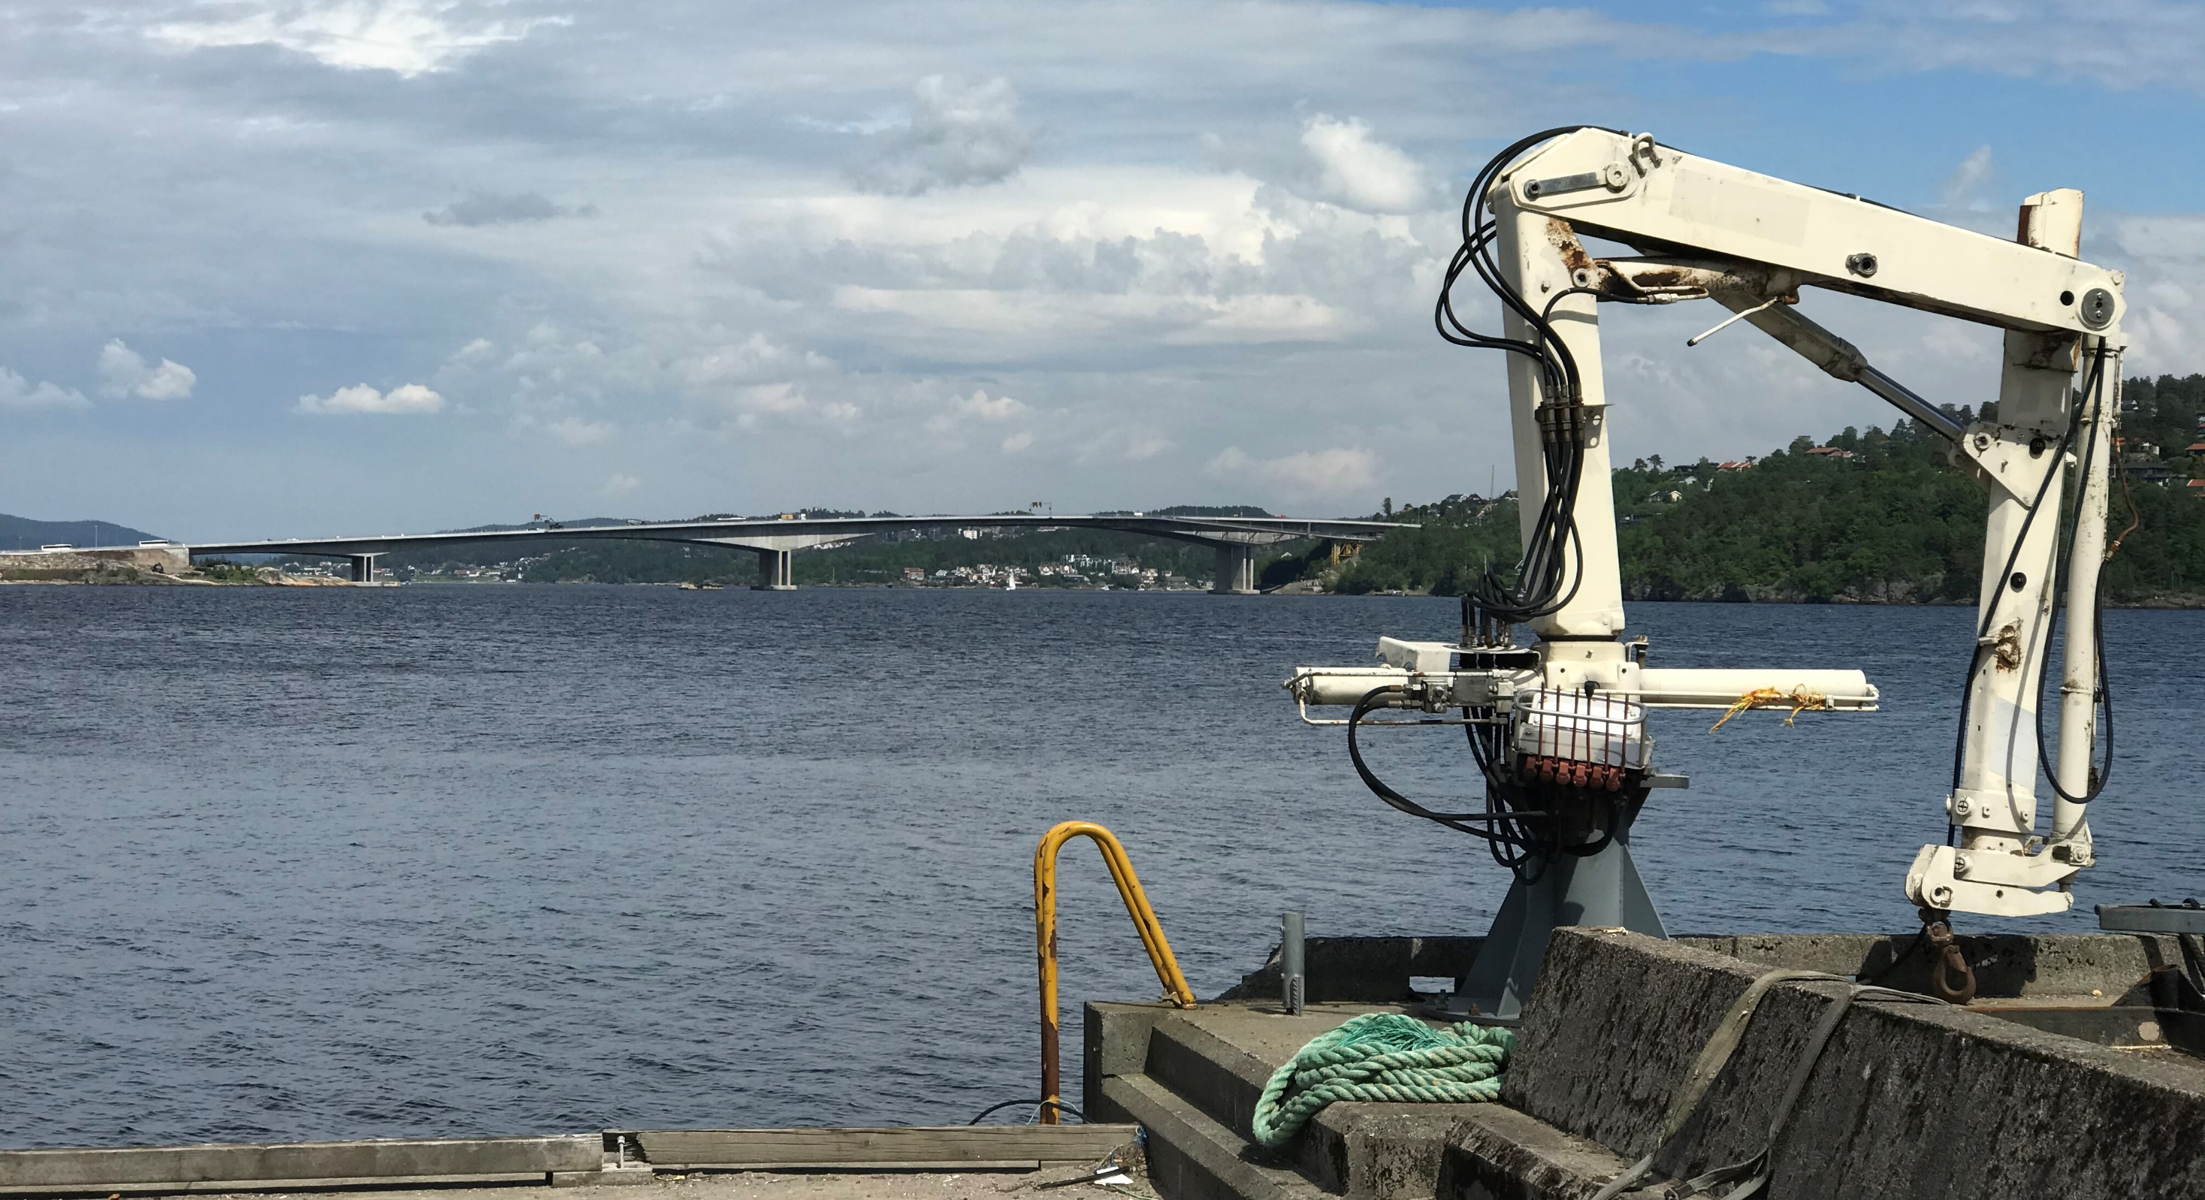
Engineers need a deep understanding of the mathematics they apply to solve problems so that their models are properly specified.

Slide 26
But that’s difficult! I teach a first-year mathematics for engineering class,

Slide 27
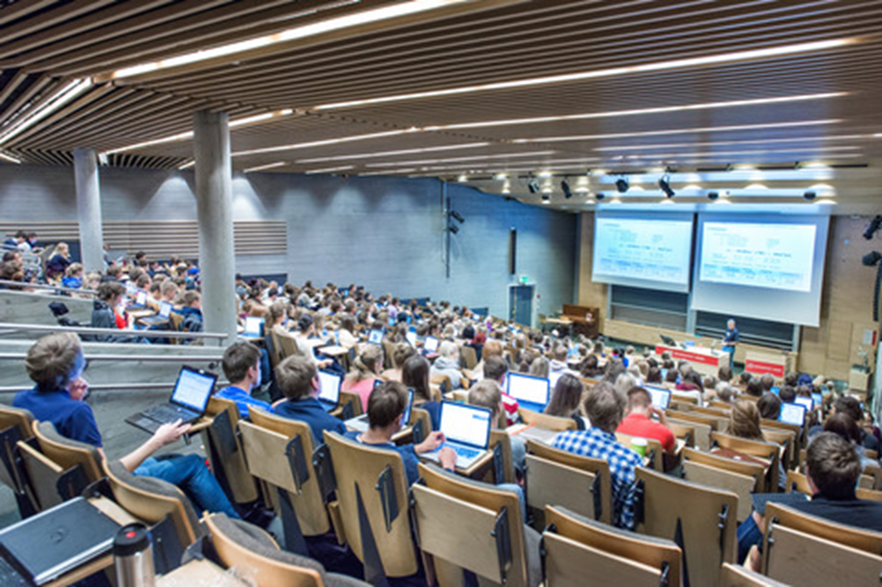
there are about 500 students who are registered on several different engineering programmes – electrical engineering, mechanical engineering, construction and so on.

Slide 28
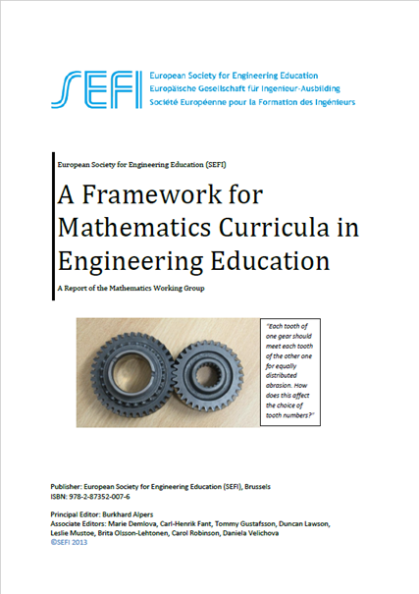
The curriculum is based on the SEFI Framework. It would be very difficult to make all the mathematics I teach always relevant to all of the students.

Slide 29
The [students’] development of a proper metaconcept … relieves the teacher of the necessity of doing ‘interesting’ things every lesson: it makes teaching mathematics within [an educational] system possible.
Reference
Howson, A. G. and Mellin-Olsen, S. (1986). Social norms and external evaluation.

Slide 30
A person’s metaconcept of mathematics is a belief about the nature, structure and coherence of mathematics, - it provides (the learner with) a concept-context within which the interpretation of new (mathematical) experiences might be made.

Slide 31
A person’s metaconcept of learning mathematics is about the nature and purpose of learning experiences and what constitutes appropriate responses to experiences with ‘learning potential’.

Slide 32
I still do not see how that can be achieved in the circumstances I have to work with. As I have said, I have a very large group of students in my first-year cohorts, and a full and demanding syllabus, have you looked at the SEFI Framework for Mathematics?

Slide 33
It is very difficult to do anything innovative with a highly heterogeneous group of students composed from several study programmes.

Slide 34
An example from the Department of Engineering Sciences at UiA
Grimstad Campus

Slide 35
Reference:
Savage, M., & Grove, M. (2015).
Mathematical modelling and problem solving in real-world physical situations.
In M. Grove, T. Croft, J. Kyle, & D. Lawson (eds.), Transitions in Undergraduate Mathematics Education, (pp. 115-127).

Slide 36
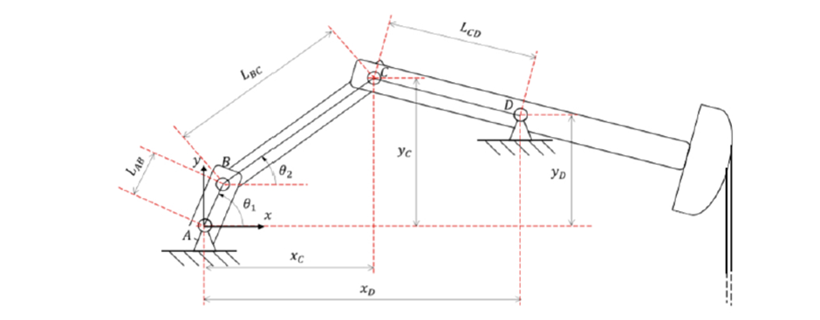

Slide 37
Teachers’ goals
To develop students’ competence in good communication of mathematics (including use of LaTeX).
To focus students on conceptual understanding.
To develop students’ self-efficacy – as a means of promoting deep learning approaches.

Slide 38
Outcomes
Some students did not engage
Concern about time demand on teachers

Slide 39
It was a feasibility study … and it worked!
Thought needs to be given to engaging more students more deeply.
Need to measure payoff – students’ attitudes, study patterns, motivation, performance, progression and completion rates … to explore whether the time investment is worthwhile
Outcomes
Some students did not engage
Concern about time demand on teachers

Slide 40
Economy of scale in higher education means:
Large groups make active learning approaches difficult.
Large cohorts make it difficult to include all students as active partners in their education.

Slide 41
Economy of scale in higher education means:
Difficult to provide meaningful and timely feedback to students about their performance.
Examinations tend to focus on procedural mathematics

Slide 42
Economy of scale in higher education means:
limited opportunity we have to develop sound teacher-student relationships and make students feel themselves to be part of a community committed to knowledge creation.
The learning milieu is weak, and it is very difficult to establish the independent learning approaches upon which higher education relies, - and needs to foster.

Slide 43
But there are examples of sustained determined effort to transform and improve teaching and learning, even in the most challenging situations, that demonstrate the possibility of change for the better!

Slide 44
Going back to your example of the modelling project as one of the first things students experience in their first half semester. My concern is that some students would find it too difficult and give up. If the challenge is too great, the students will just drop out.

Slide 45
I certainly share your concern and I think the mentors and student learning assistants have a crucial role in the process, to ensure that the students do not give up or drop out.

Slide 46
Self Determination Theory
Edward Deci and Richard Ryan
Extrinsic and intrinsic motivation
Intrinsic motivation arises from a student’s curiosity and interest in the subject matter. Students will inquire into the subject because they want to find out more.
Intrinsically motivated students, - are likely to study for longer and engage with the material with deeper thinking and reflection.
Reference:
Deci, E.L. & Ryan, R.M. (2000).
Intrinsic and extrinsic motivations: Classic definitions and new directions.

Slide 47
Self Theories
Carol Dweck
Attributions for success and failure
A student who sees a problem task as an opportunity to learn is more likely to engage with the problem than a student who fears failure, especially if they think that failure may make the student appear less intelligent.
Reference:
Dweck, C. (1999).
Self-Theories: Their Role in Motivation, Personality, and Development.

Slide 48
Self Theories
Carol Dweck
Attributions for success and failure
A student who sees a problem task as an opportunity to learn is more likely to engage with the problem than a student who fears failure, especially if they think that failure may make the student appear less intelligent.
Students’ attributions of success and failure can be influenced.
Reference:
Dweck, C. (1999).
Self-Theories: Their Role in Motivation, Personality, and Development.

Slide 49
It is important to convince students that being stuck is an honourable state, and an essential stage in a learning trajectory.
References:
Hawkes, T. (2015).
Problem solving in a mathematics degree.
Mason, J., Burton, L., & Stacey, K. (1982).
Thinking Mathematically.

Slide 50
Self Efficacy
Albert Bandura
A student is likely to be more ready to engage with a task if she or he feels confident that effort will be rewarded. In other words, they experience a high degree of self-efficacy to succeed in the task.
References:
Bandura, A. (1982).
Self-efficacy mechanism in human agency.
Zakariya, Y. F. (t.b.p.).
Self-efficacy between previous and current mathematics performance of undergraduate students: an instrumental variable approach to exposing a causal relationship

Slide 51
What about the exams and assessments? You have acknowledged that with large groups it is very difficult to do anything other than assess procedural competencies.

Slide 52
I know that John Biggs has written about “constructive alignment” – so that the examinations are aligned with the intended learning outcomes and the teaching approaches.
References:
Biggs, J. (1996). Enhancing teaching through constructive alignment.
Biggs, J. (n.d.). Aligning teaching for constructing learning.

Slide 53
But, if I only have the resource to assess procedural competencies, then perhaps I should adjust and align my goals and practice to that!

Slide 54
There are several innovative forms of assessment:
Group project work
Presentations
Peer assessment
…

Slide 55
MatRIC’s vision is of students enjoying transformed and improved learning experiences of mathematics in higher education.

Slide 56
Where should I begin?

Slide 57
Where should I begin?

Slide 58
Where should I begin?
Begin in a modest way …
Take just one small step, and then make a determined effort to keep moving along a developmental trajectory.
Encourage colleagues to join you …

Slide 59
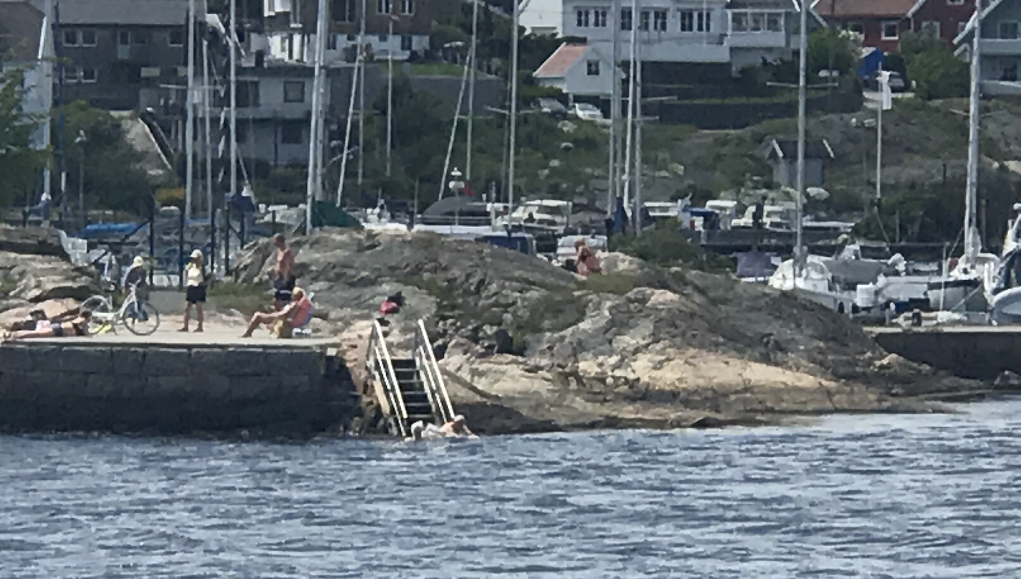
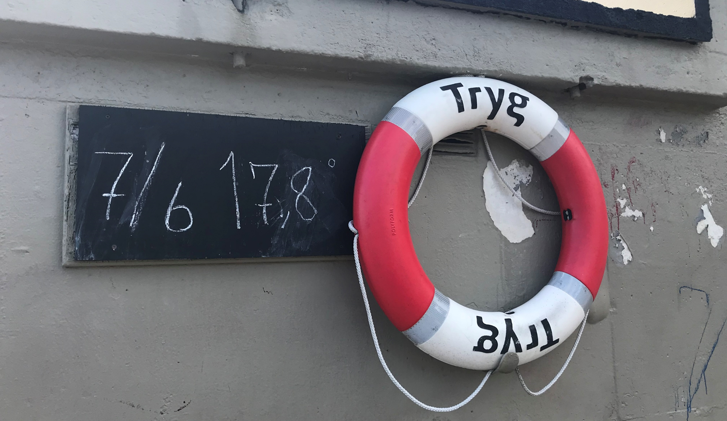
Be brave – jump in!
Water temperature in the fjord is 17,8° C

Slide 60
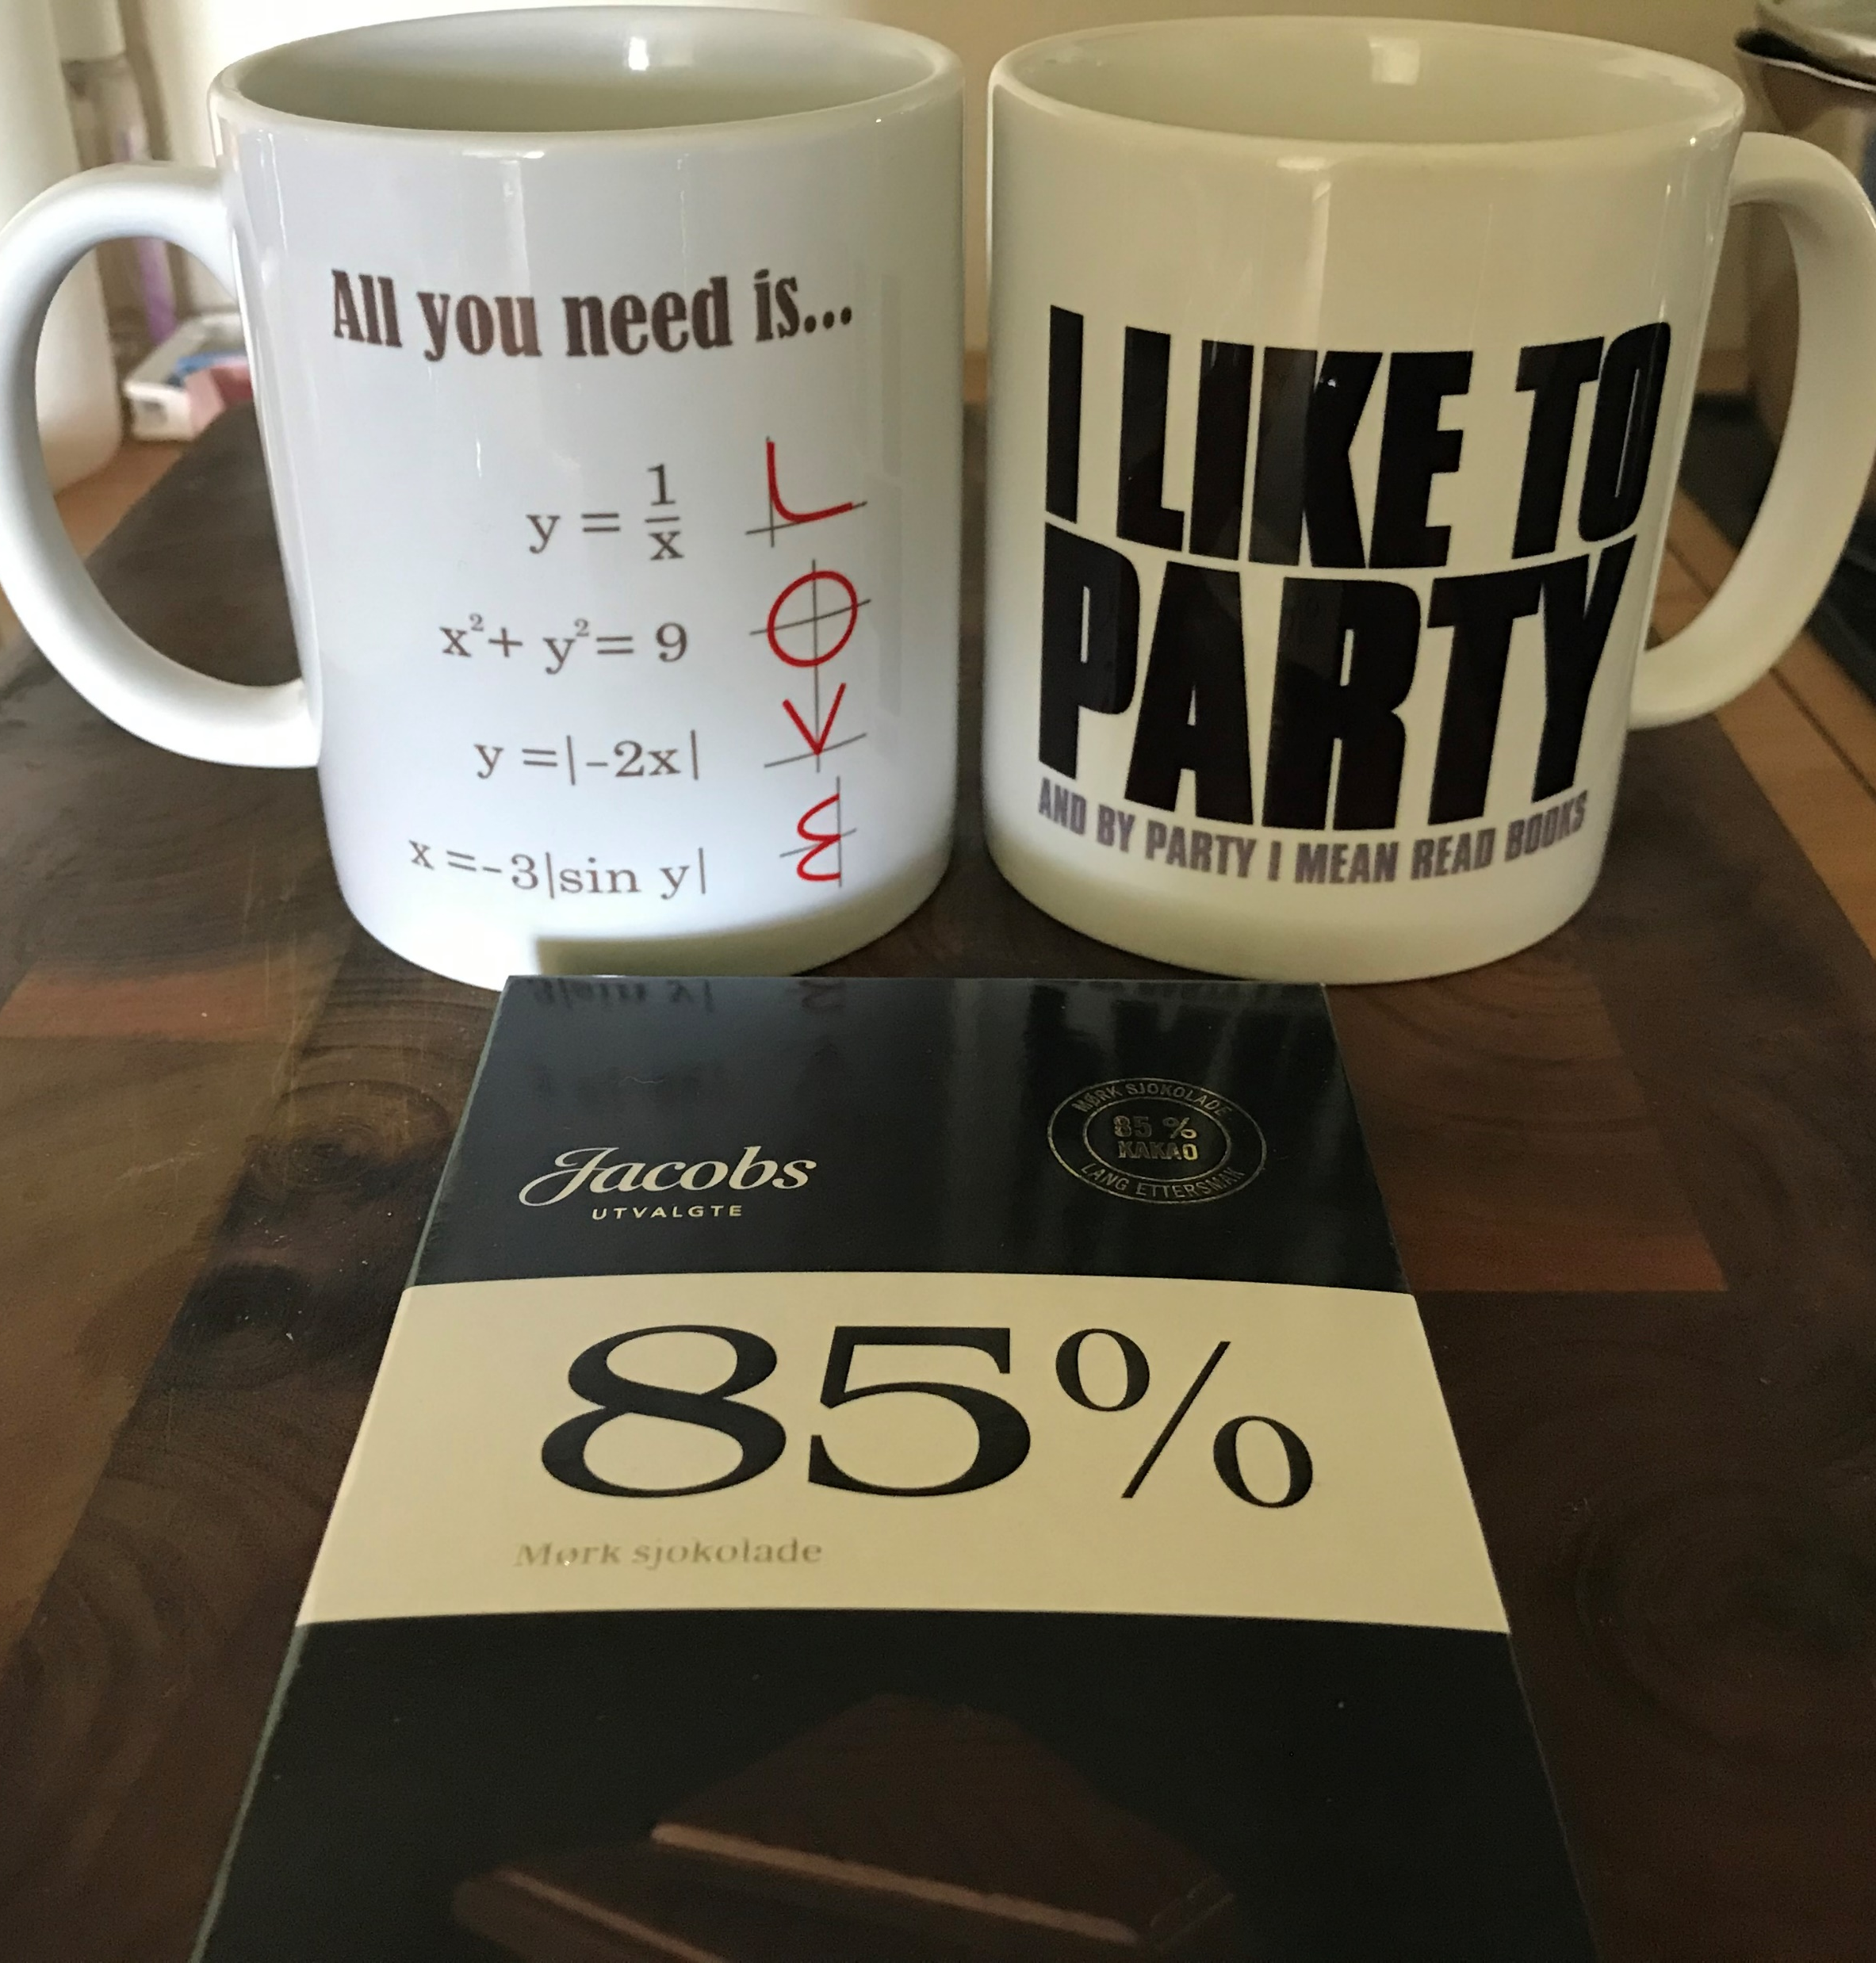
Time for a break!
Thank you for your attention!

